Slide 1
Power of AI in Railroad
Subhadip Kumar (Deep)

Slide 2
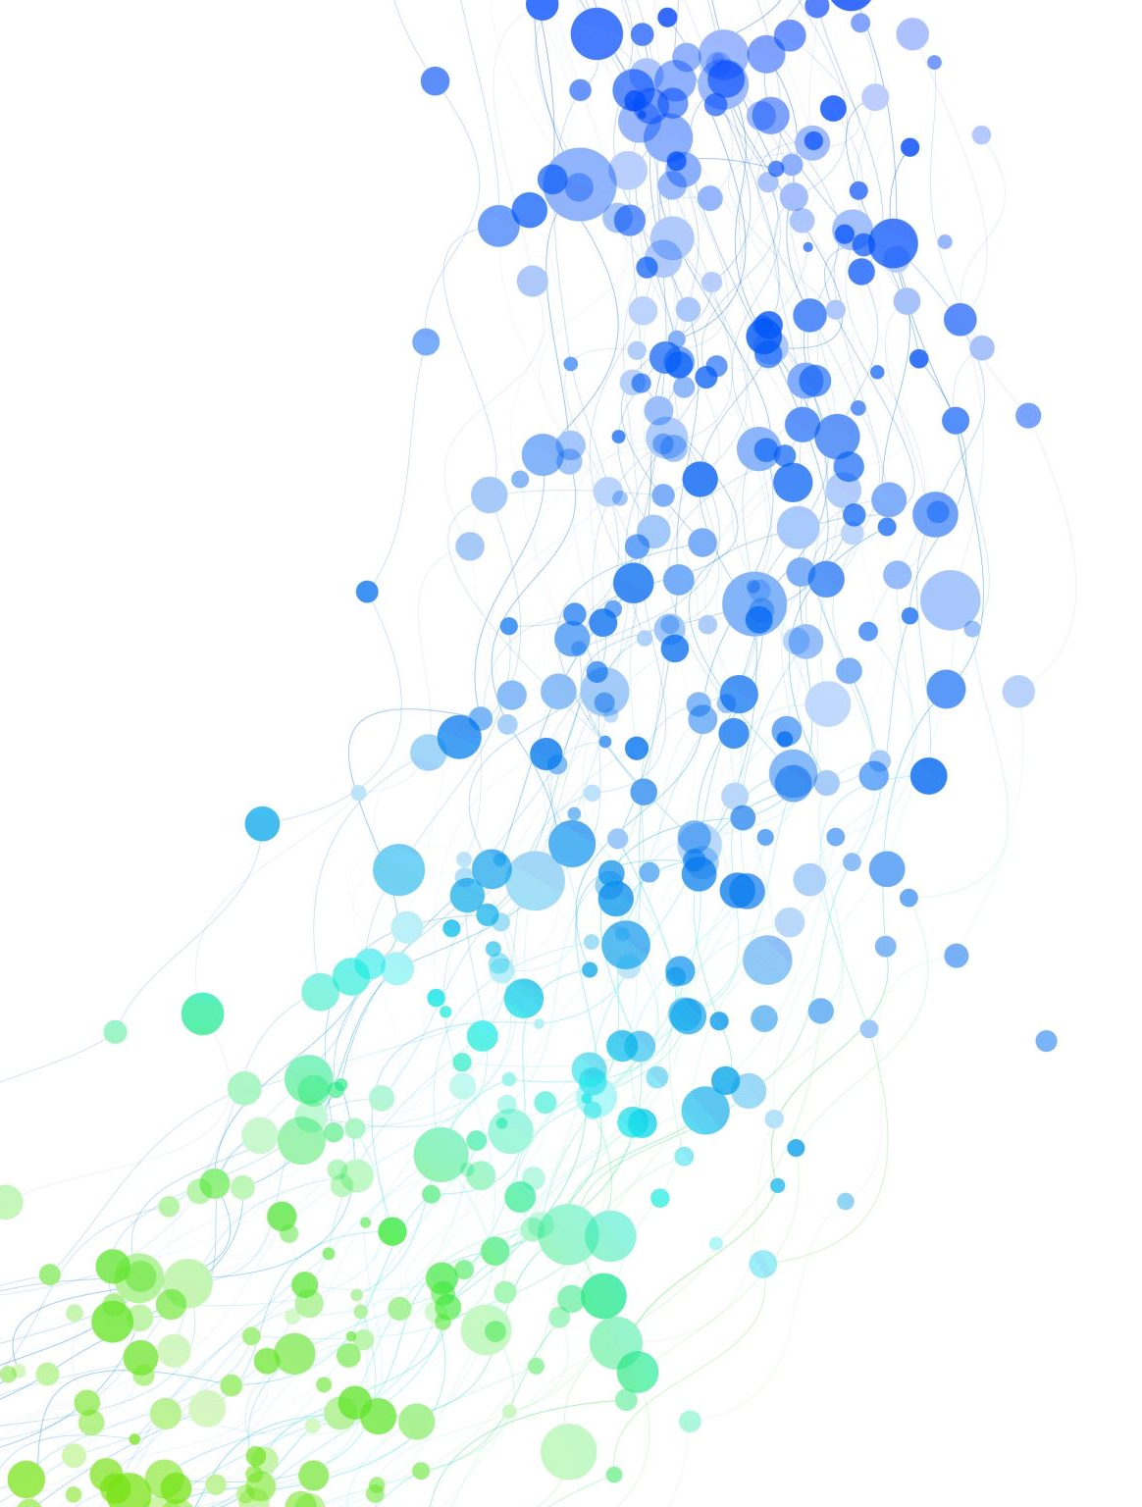
Introduction
Subhadip Kumar is a seasoned IT professional with over 18 years of experience, currently serving as a Senior Technology Specialist and Architect. Subhadip brings together extensive technical expertise and a profound understanding of business operations. Subhadip’s distinctive approach is characterized by the fusion of technical acumen with a deep comprehension of core business functions.

Slide 3
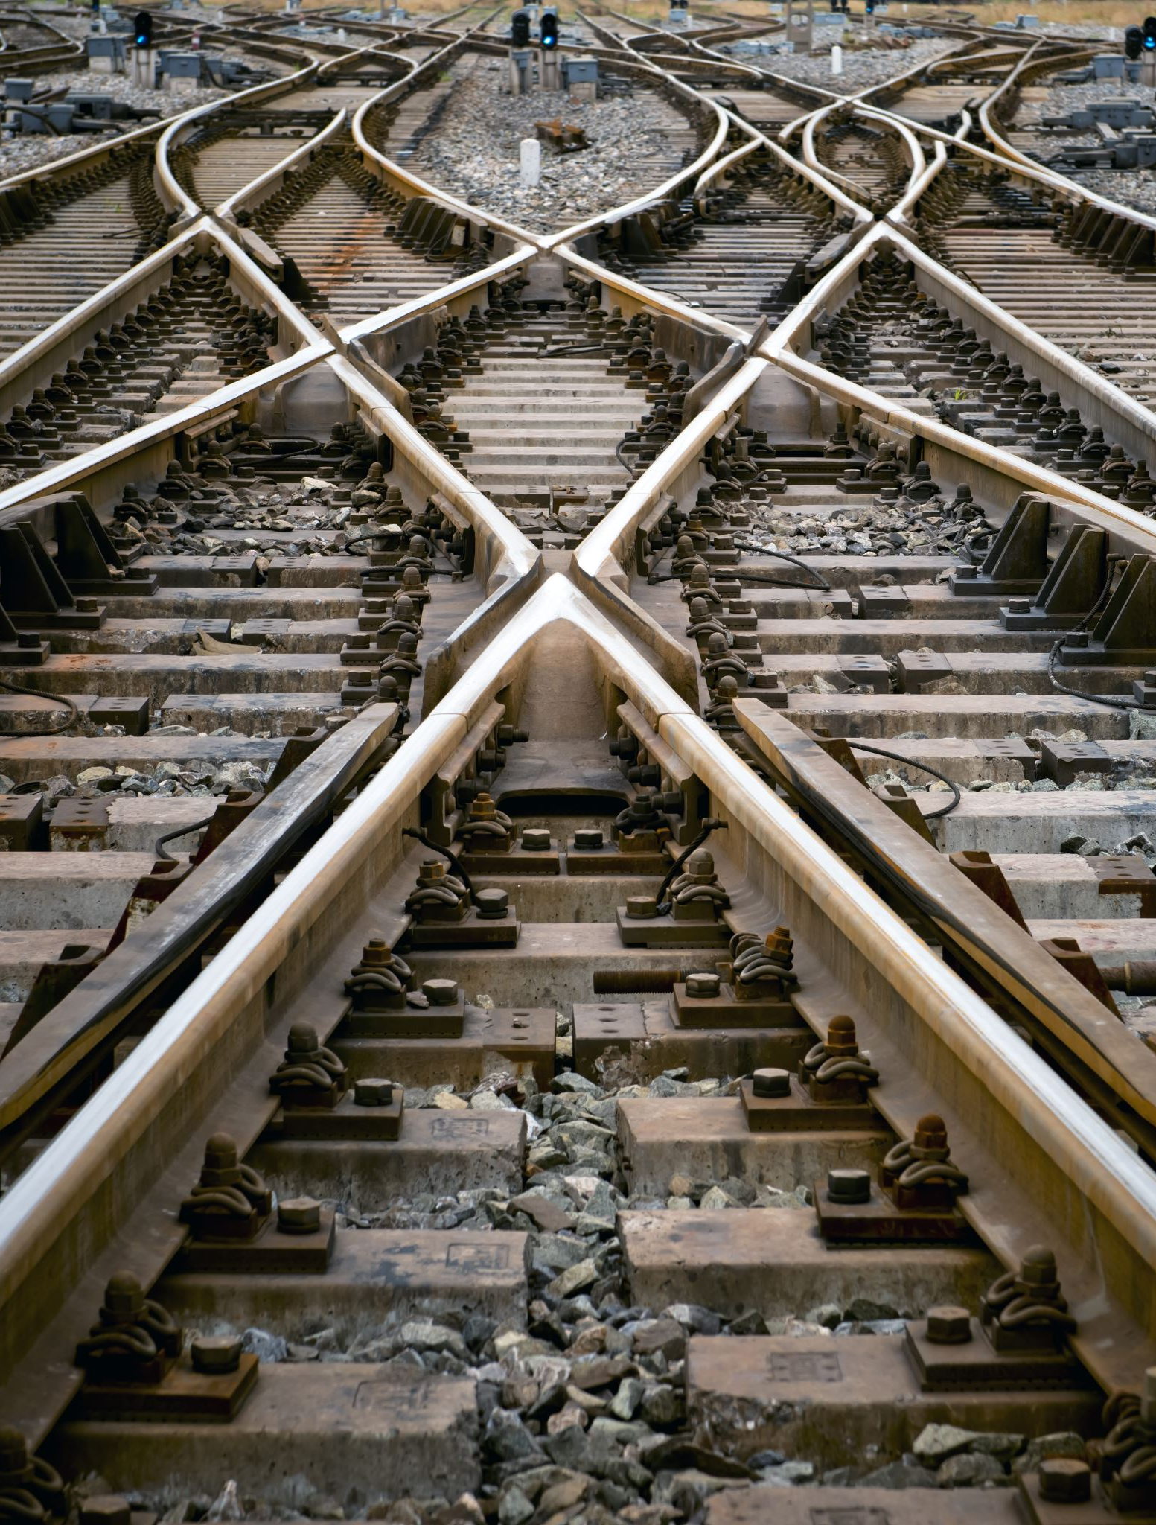
Agenda
Brief Introduction of Railroad Industry and it’s complex nature of business.
Significance of AI incorporation in Railroad
Current Scope and Implementation
Future scope

Slide 4
Complexity of railroad business in North America
Tracks
Locomotives
Car
Yard, bridges and tunnels
Freight
Crew
Notes:
Facts: Railroads are lifeblood of Supply ChainTogether, these railroads cover more than 200,000 miles of track in North America. Out of that 70000 miles are in dark territory
In the United States alone, railroads ship around 61 tons of goods per person every year, ranging from raw materials to finished products
Greenest mode of transportation
Class I railroads: BNSF, CN, CPKC, CSX, UP, NS, Amtrak
Types of freight cars – Flatcar, Tankcar, Hopper, Boxcar, Refrigerator car, autorack. Train General Bulletin Order (TGBO), Track Authority
Freight Type – Grain, automotive, fertilizers, Chemicals and Hazmat, Oil, Wheat/Barnel, fertilizer, sodaash (Hopper), Metal, Appliances, Food products (Box Car), chemicals, molasses, edible tallow, water, diesel fuel and ethanol (Tank car)

Slide 5
SIGNIFANCE OF AI in RAILROAD
Preventive Maintenance
Structural Health Monitor (SHM) - Bridges, Tracks, Tunnels
Prognostic and Health Management (PHM) – Leveraging Sensors, advanced cameras, drones
Yard Management – Intermodal yard and Hump yard
Crew Management
Revenue forecast
Demand forecast
Fuel cost prediction
Chatbot
Notes:
Predicting when recrews will be required and decreasing crew call departure time

Slide 6
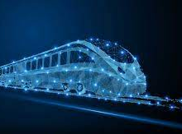
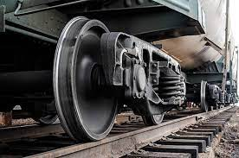
Current SCOPE
Digital Twin
Tech-enabled train building
Optimizing Wheel Life and Performance
Crew Management
Notes:
Digital Twin is helping on Structural Health Monitor (SHM). Sensors and advanced cameras. Lidar Scanner such as Leica BLK 360 device, 3D camera was used. Osong Railway Test track, which is a 13 km long railway line in South Korea. The main objective of the study was to scan a 4 km section of tunnel using a 3D lidar device and create a digital twin space. BIM (Building Information Modeling) techniques aka digital twin and Revit software. Revit is a software application that supports BIM workflows for architecture, engineering, and construction.
Tech enabled train building – Calculate the best route, order of cars to ensure a safe journey, precision train building that is robust physics and simulation that can predict the in-train forces that may occur during a trip to build safe trains, how a train will handle while enroute, where cars should be placed in the lineup, the number of locomotives needed and the best route.
Another important aspect is optimizing wheel life and performance – Wheel replacement is approximately 60% of total maintenance cost. AI is helping to predict the remaining wheel life. It helps to determine how far we can accurately predict, it can help to span operating cost to be divided in multiple quarters, reduce stock out cost, prevent early wheel replacement, eliminates manual errors and helps to take augmented decisions. Acoustic detector, hot wheel detector, cold wheel detection
Crew management: Train ETA to crew change location, Predicting when recrews will be required and decreasing crew call departure time,
Fuel cost prediction

Slide 7
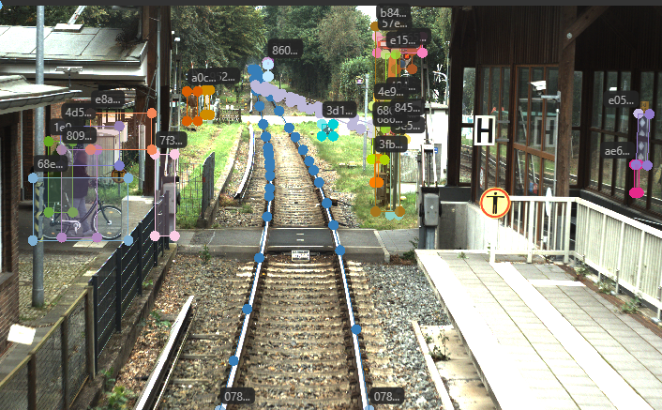
FUTURE SCOPE
Automatic Train Operation – Improving grade of automation
Carloads prediction
Augmented Computer Vision
Improving dark territory
Dashboards
Notes:
SAE classification from GoA1 to GoA4. AI can help to improve GoA from 1 to 2
PTC – Initial plan to implement 100% by 2015 exteneded 2 times – finally implemented in 2020.
Predicting carload volume based on weather, manage crew demand accordingly. Adjust revenues
The railway market, particularly in locomotives and passenger trains, has seen a substantial adoption of GNSS technology (Global Navigation Satellite System), with approximately 250,000 devices installed – accurately locate the locomotives,

Slide 8
CONCLUSION
Railroads are slowly adopting the power of AI, IoT, Computer Vision and ML to improve the efficiency of their operations and services. These technologies enable railroads to collect, analyze, and act on large amounts of data from various sources, such as sensors, cameras, GPS, and weather stations. By using AI and ML, railroads can optimize train scheduling, routing, speed, and fuel consumption, as well as predict and prevent failures, accidents, and delays.

Slide 9
Q&A

